Slide 1
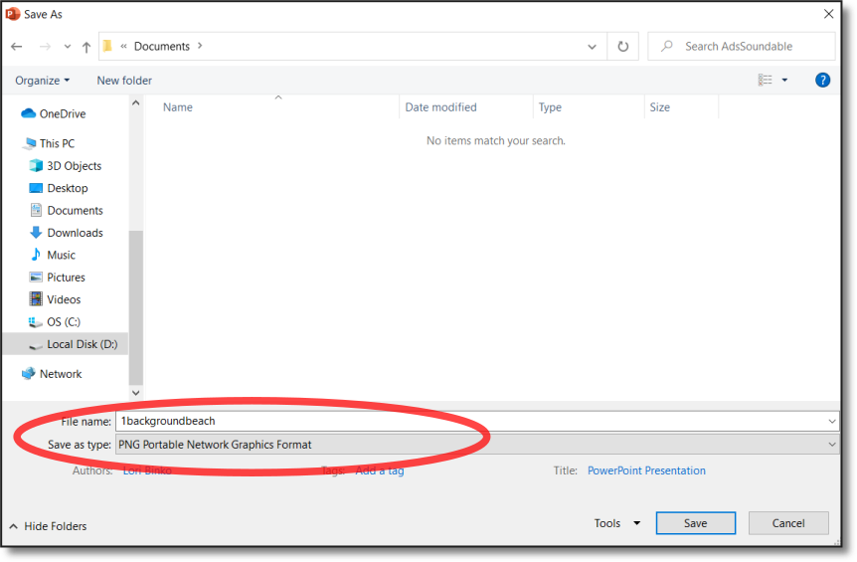
Make Your Virtual Background
Use the LessonPix Add-in to place visuals in a static location.
text
Place your symbols on the sidebar (ie: rules or cues)
Add background image and send it to the back
text
“Save As” a PNG file
Import in your Zoom background
text

Slide 2
text
text
text

Slide 3
text
text
text
text
text

Slide 4
text
text
text
text
text
text
text
text
text
text

Slide 5
Hello
Check your mic
Ready to Learn

Slide 6
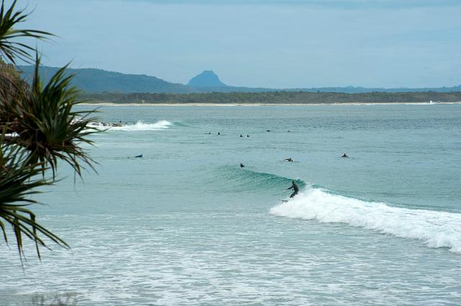
Hello
Check your mic
Ready to Learn

Slide 7
Hello
Check your mic
Ready to Learn

